Slide 1
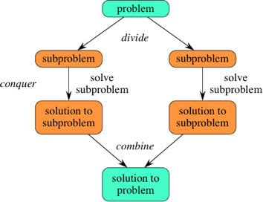
Divide and Conquer
Breaking large problems into smaller subproblems
Binary Search
Binary Search Experiments
Merge Sort
Merge Sort Experiments
Recursive Methods

Slide 2

Iterative Searches
The previous slides on iterative algorithms introduced search algorithms that did a “linear scan” through a list
  to find a particular item: search(a,x)
    start at the front of a, scan right until x found
  to find the largest item: max(a)
    set place-holder to a[0], scan from a[1] to a[n-1], updating place-holder

Slide 3
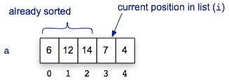
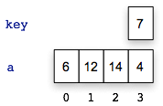
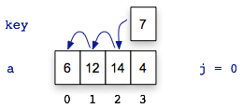
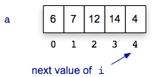
Simple Sorts
Those slides also introduced a sorting algorithm that used a similar strategy
Scan the list from left to right, and for each item x:
  remove x from the list
  scan left to find a place for x
  re-insert x into the list
This “insertion sort” algorithm has nested loops
  outer loop is a linear progression left to right
  inner loop scans back to find a place for x
The number of comparisons made when sorting
a list of n items is as high as

Slide 4

Divide and Conquer
The common theme for the previous slides: iterate over every location in the list
The common theme for this chapter’s slides: divide and conquer
  break a problem into smaller pieces and solve the smaller sub-problems
It may not seem like that big a deal, but the improvement can be dramatic
  approximate number of comparisons (worst case):
search
 | n = 100 | n = 1,000
search | 100 | 1,000
bsearch | 7 | 10
sort
 | n = 100 | n = 1,000
isort | 5,000 | 500,000
msort | 700 | 10,000

Slide 5

Searching a Dictionary
To get a general sense of how the divide
and conquer strategy improves search,
consider how people find information in
a phone book or dictionary
  suppose you want to find “janissary” in
  a dictionary
  open the book near the middle
  the heading on the top left page is “kiwi”,
  so move back a small number of pages
  here you find “hypotenuse”, so move forward
  find “ichthyology”, move forward again
The number of pages you move gets
smaller (or at least adjusts in response
to the words you find)

Slide 6
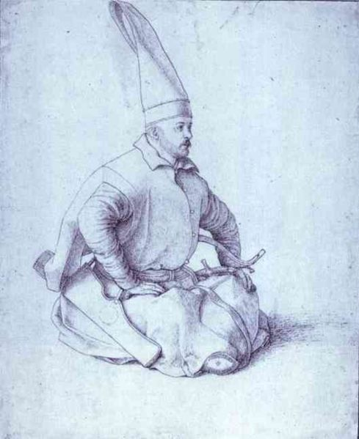
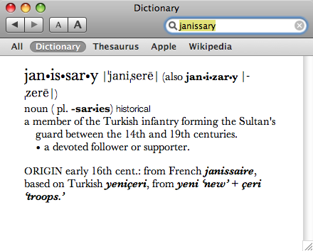
Searching a Dictionary
A detailed specification of this process:
  the goal is to search for a word w in region
  of the book
  the initial region is the entire book
  at each step pick a word x in the middle of
  the current region
  there are now two smaller regions: the part
  before x and the part after x
  if w comes before x, repeat the search on the
  region before x, otherwise search the region
  following x (go back to step 3)
Note: at first a “region” is of a group of pages,
but eventually a region is a set of words on
a single page

Slide 7


A Note About Organization
An important note: an efficient search depends on having the data organized in some fashion
  if books in a library are scattered all over the place we would have to do an iterative search
  start at one end of the room and progress toward the other
If books are sorted or carefully cataloged we can try a binary search or other method
http://www.endlessbookshelf.net/shelves.html

Slide 8
Binary Search
The binary search algorithm uses the divide-and-conquer strategy to search through an array
The array must be sorted
  the “zeroing in” strategy for looking up a
  word in the dictionary won’t work it the
  words are not in alphabetical order
  binary search will not work unless the
  array is sorted

Slide 9
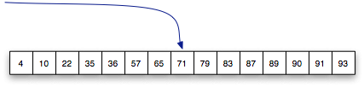


Binary Search
To search a list of n items, first look at the item in location n/2
  then search either the region from 0 to n/2-1
  or the region from n/2+1 to n-1
Example: searching for 57 in a sorted list of 15 numbers
start in the middle
③
②
①

Slide 10

Detailed Description
The algorithm uses two variables to keep track of the boundaries of the region to search
  lower the index one below the leftmost item in the region
  upper the index one above the rightmost region
[
]
initial values when searching an array of n items:
lower = -1
upper = n

Slide 11
Detailed Description
The algorithm is based on an iteration (“loop”) that keeps making the region smaller and smaller
  the initial region is the complete array
  the next one is either the upper half or lower half
  the one after that is one quarter, then one eighth, then...
[
]
initial values when searching an array of n items:
lower = -1
upper = n

Slide 12
Detailed Description
The heart of the algorithm contains these operations:
  mid = (lower + upper) / 2
  return mid if k == a[mid]
  upper = mid if k < a[mid]
  lower = mid if k > a[mid]
The first iteration when searching for 57 in a list of size 15:
[
]
*
lower = -1
upper = 15
mid = 14 / 2 = 7
upper for next iteration: 7

Slide 13
Detailed Description
mid = (lower + upper) / 2return mid if k == a[mid]upper = mid if k < a[mid]lower = mid if k > a[mid]
The remaining iterations when
searching for 57:
  lower = -1
  upper = 7
  mid = 3
  lower = 3
  lower = 3
  upper = 7
  mid = 5
  found it!
[
*
]
[
*
]
This search required only 3 comparisons:
a[7], a[3], a[5]

Slide 14
Unsuccessful Searches
mid = (lower + upper) / 2return mid if k == a[mid]upper = mid if k < a[mid]lower = mid if k > a[mid]
What happens in this algorithm
if the item we’re looking for
is not in the array?
Example: search for 58
  lower = 3
  upper = 7
  mid = 5
  lower = 5
  lower = 5
  upper = 7
  mid = 6
  upper = 6
  lower = 5
  upper = 6
  mid = 5
  lower = 5
[
*
]
[
*
]
uh-oh... lower
didn’t change!
[
]

Slide 15
Unsuccessful Searches
To fix this problem we have to add another condition to the loop
  we want the result to be nil if the region shrinks to 0 items
  this happens when upper equals lower + 1
  mid = (lower + upper) / 2
  return nil if upper == lower + 1
  return mid if k == a[mid]
  upper = mid if k < a[mid]
  lower = mid if k > a[mid]

Slide 16
if Statements
Usually when a program has tests for opposite conditions the test is written in the form of an if statement
Instead of
  upper = mid if k < a[mid]
  lower = mid if k > a[mid]
we normally write
  if k < a[mid]
  upper = mid
  else
  lower = mid
  end
if and else are keywords

Slide 17
if Statements
If there are three conditions we can use elsif (a combination of if and else):
  if k == a[mid]
  return mid
  elsif k < a[mid]
  upper = mid
  else
  lower = mid
  end

Slide 18
Binary Search Method
The full definition of a method
that does a binary search of an
array a to look for an item x is
shown at right
  the name is bsearch to
  distinguish it from the
  search method shown
  in the previous slides
def bsearch(a, k) lower = -1 upper = a.length while true mid = (lower + upper) / 2 return nil if upper == lower + 1 if k == a[mid] return mid elsif k < a[mid] upper = mid else lower = mid end endend
Is this an infinite loop??

Slide 19
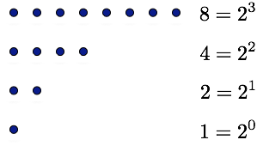

Number of Comparisons
When we’re searching we’re
reducing an area of size n down
to an area of size 1
  e.g. n = 8 in this diagram
A successful search might return
after the first comparison
An unsuccessful search does
all iterations

Slide 20
Recursion
In computer science a recursive description of a problem is one where
  a problem can be broken into smaller parts
  each part is a smaller version of the original problem
  there is a “base case” that can be solved immediately (i.e. it has no sub-problems)
Binary search can be described recursively:
  search(a, k, lower, upper):
  mid = (lower + upper) / 2
  return nil if mid == lower
  return mid if k == a[mid]
  return search(a, k, lower, mid) if k < a[mid]
  return search(a, k, mid, upper) if k > a[mid]
base cases -- no further breakdown required
recursion-- smaller instances of the original problem

Slide 21
Recursive Methods
We can write recursive methods in Ruby
  the body of a method will have a call to itself
  see rsearch in RecursionLab
default values for lower, upper
def rsearch(a, k, lower = -1, upper = a.length) mid = (lower + upper) / 2 if mid == lower return nil elsif a[mid] == k return mid elsif k < a[mid] return rsearch(a, k, lower, mid) else return rsearch(a, k, mid, upper) endend
method calls itself...

Slide 22
Recursive Methods (cont’d)
  >> rsearch(a, 29)
  [ 12 19 29 *58 68 72 96 98 ]
  [ 12 *19 29 ] 58 68 72 96 98
  12 19 [ *29 ] 58 68 72 96 98
  => 2
initial call, lower = -1, upper = 8
recursive call, lower = -1, upper = 3
recursive call, lower = 1, upper = 3
location where 29 was found
def rsearch(a, k, lower = -1, upper = a.length) mid = (lower + upper) / 2 if mid == lower return nil elsif a[mid] == k return mid elsif k < a[mid] return rsearch(a, k, lower, mid) else return rsearch(a, k, mid, upper) endend

Slide 23
Divide and Conquer Sorting Algorithms
The divide and conquer strategy used to make a more efficient search algorithm can also be applied to sorting
Two well-known sorting algorithms:
QuickSort
  divide a list into big values and small values, then sort each part
Merge Sort
  sort subgroups of size 2, merge them into sorted groups of size 4, merge those into sorted groups of size 8, ...
The remaining slides will have an overview of each algorithm, and a look at how Merge Sort can be implemented in Ruby

Slide 24
Merge Sort
The merge sort algorithm works from “the bottom up”
  start by solving the smallest pieces of the main problem
  keep combining their results into larger solutions
  eventually the original problem will be solved
Example: sorting playing cards
  divide the cards into groups of two
  sort each group -- put the smaller of the two on the top
  merge groups of two into groups of four
  merge groups of four into groups of eight
  ...
  [ see example next slide ]

Slide 25
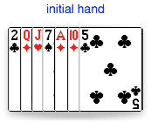
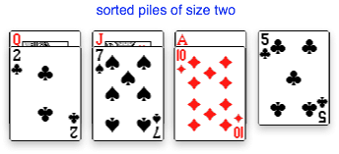
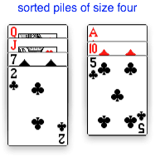
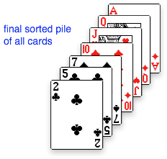
Merge Sort (cont’d)
Example with a hand of seven cards

Slide 26
Merge Sort
What makes this method more
effective than simple insertion sort?
  merging two piles is a very simple
  operation
  only need to look at the two cards
  currently on the top of each pile
  no need to look deeper into either
  group
In this example:
  compare 2 with 5, pick up the 2
  compare 5 with 7, pick up the 5
  compare 7 with 10, pick up the 7
  ....

Slide 27





Merge Sort
Another example, using an array of numbers
  sorted blocks are indicated by adjacent cells with the same color

Slide 28
msort Demo
The merge sort algorithm has been implemented in RubyLabs as a method named msort
  more complicated than most algorithms in the book
  described in the text, if you want to learn more (but it’s optional reading)
What you should know:
  size, the variable that defines the group size, is initialized to 1
  group size doubles on each successive iteration of the main loop
  a helper procedure named merge, called from the main loop, does the hard work
The first statement in the main loop is on line 5
  we’ll attach a probe here to look at the array at the start of each iteration
  a special version of brackets will draw pairs of brackets around each group

Slide 29
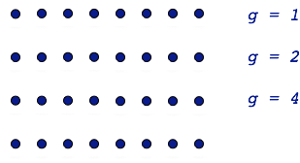
Comparisons in Merge Sort
To completely sort an array with n items requires log2 n iterations
  the group size starts at 1 and
  doubles on each iteration
During each iteration there are
at most n comparisons
  comparisons occur in the
  merge method
  compare values at the front
  of each group
  may have to work all the way
  to the end of each group, but
  might stop early (e.g. with cards
  one pile is emptied but more
  than one left in the other pile)
Total comparisons ≈

Slide 30
QuickSort
QuickSort is another divide-and-conquer sorting algorithm
The main idea is to partition the array into two regions:
  small items are moved to the left side of the array
  large items are moved to the right side
After partitioning, repeat the sort on the left and right sides
  each region is a sub-problem, a smaller version of the original problem
Main question: how do we decide which items are “small” and which are “large”?
A common technique: use the first item in the region as a pivot
  everything less than the pivot ends up in the left region
  items greater than or equal to the pivot go in the right region

Slide 31






Partition Example
The partitioning algorithm works from both ends
When it finds a large item on the left and a small item on the right it swaps them
When there are no more exchanges to make the two regions are complete
Numbers below 79
Numbers 79 and above

Slide 32
QuickSort Algorithm
Since the partition step does all the hard work the QuickSort algorithm is straightforward
Here is the outline:
  qsort(a, lower, upper):
  if lower < upper
  mid = partition(a, lower, upper)
  qsort(a, lower, mid)
  qsort(a, mid+1, upper)
Base case: empty region
The call to partition returns the location of the boundary between sub-regions
Recursive calls to sort each sub-region

Slide 33
QuickSort Performance
QuickSort is not guaranteed to be more efficient than Insertion Sort
  if it makes an unlucky choice for the pivot the array will not be divided equally
  worst case: sorting an array that is already in order
The analysis of the average number of steps for random lists is fairly complex
Bottom line: to sort a list of n items requires approximately
Many tests on real-world data show that QuickSort is very effective in practice and it is a popular choice in many applications

Slide 34
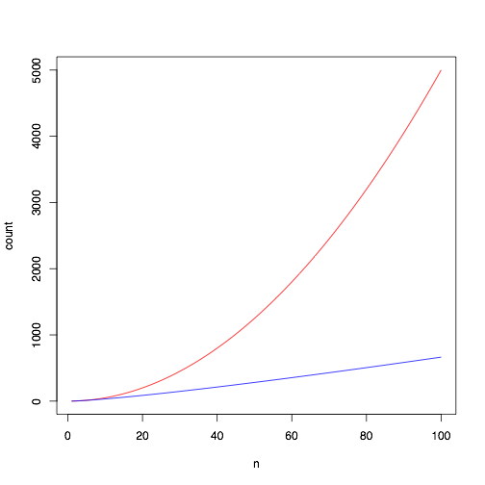
Recap: Divide and Conquer Algorithms
The divide and conquer strategy often reduces the number of iterations of the main loop from n to log2 n
  binary search:
  merge sort:
  QuickSort:
It may not look like much, but the reduction
in the number of iterations is significant for
larger problems

Slide 35
Summary
These slides introduced the divide and conquer strategy
  for searching: binary search
    requires list to be sorted
  for sorting: QuickSort and merge sort
Binary search will find an item using at most comparisons
QuickSort and merge sort do at most comparisons
An algorithm that uses divide and conquer can be written using iteration or recursion
  recursive = “self-similar”
  a problem that can be divided into smaller subproblems of the same type
  a recursive method calls itself

